Slide 1
RI CHW Voices november 25 2024

Slide 2
agenda
Welcome & Icebreaker Activity
Meet RI Champions & Allies
Resources
Upcoming Opportunities
Close & Evaluation

Slide 3
Share one thing you learned from an elder?

Slide 4
Conversations w/ RI Older Adult Champions & Allies

Slide 5
RI Department of Health Initiatives
Notes:
Gerry can take this slide. We can also invite any guest from RIDOH to speak.
Alzheimer's Disease and Related Disorders Program: Reduce the health and economic burden associated with Alzheimer’s disease and related disorders by monitoring the burden of Alzheimer’s in Rhode Island, educating individuals and their families on the prevention, diagnosis, and treatment of Alzheimer’s disease, and improving the quality of care, education, and support. https://health.ri.gov/programs/detail.php?pgm_id=156674
Community Health Network: Connects patients with evidence-based chronic disease self-management and prevention programs. https://health.ri.gov/programs/detail.php?pgm_id=1119
Healthy Eating and Active Living (HEAL): To advance health equity for healthy eating and active living by collaboratively working with partners to improve policy, system, and environmental changes. https://health.ri.gov/programs/detail.php?pgm_id=156699

Slide 6
Working Together for a Safe and Just Elder Community

Slide 7
WHAT BROUGHT ME TO THIS WORK?
In 2020, during the pandemic, I changed my career from being a Behavioral Consultant for school-age students on the spectrum to looking for new job opportunities. I started working at East Bay Community Action Program (EBCAP). Over the past four years at EBCAP, I first worked in the residential program. After six months, I moved to the Community Health Team as a Health Advocate. In this role, I quickly discovered gaps in the agency's social services. While working with clients who survived abuse, many said the agency did not have enough resources. This feedback led me to start looking for more support for those in need.

Slide 8
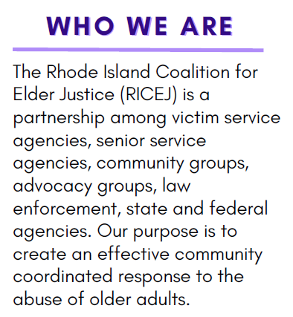

Slide 9
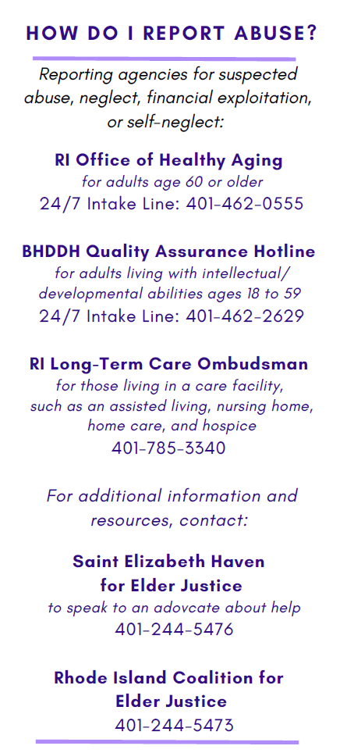

Slide 10
Thank you
Alisha Bertrand BS,(She, her) Lead Health &VOCA Advocate East Bay Community Action Program
Cell : 401-450-5517 Work: 401-437-1000 extension 1009

Slide 11
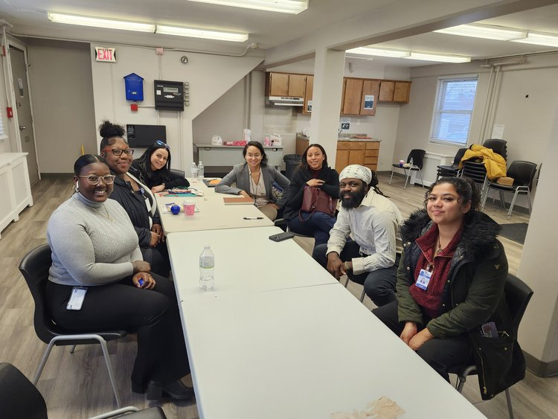
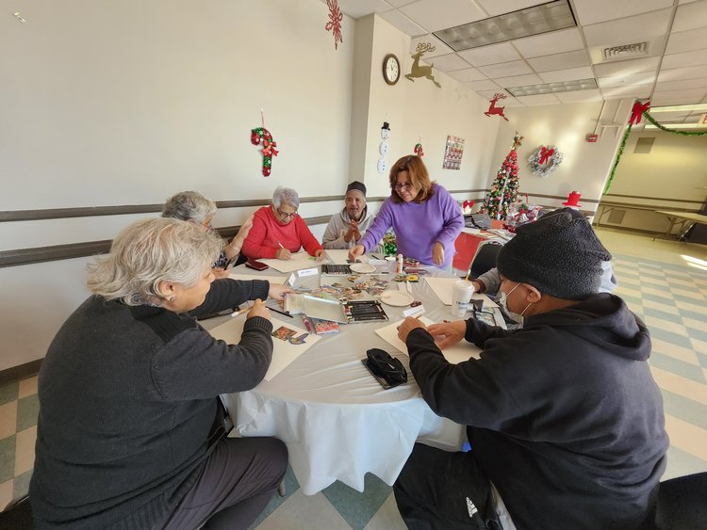
Arts for every body project
Notes:
https://www.artsforeverybody.org/providence-ri
The Providence project is a partnership between the Healthy Communities Office, Providence Housing Authority (PHA) and the Providence Department of Arts, Culture, and Tourism. The team has created artist residencies at PHA sites. As part of their residency, participating artists are engaging residents in arts activities and work alongside embedded community health workers (CHWs) to better understand the wellness goals of residents. CHWs will connect residents to available City/community resources, and the artists co-create with residents and design a culminating artwork or performance at each site. The process is focusing on healing, social connectedness, self-discovery and home.
National Arts for EveryBody Campaign aims to show how arts participation is good for both physical and mental health.

Slide 12
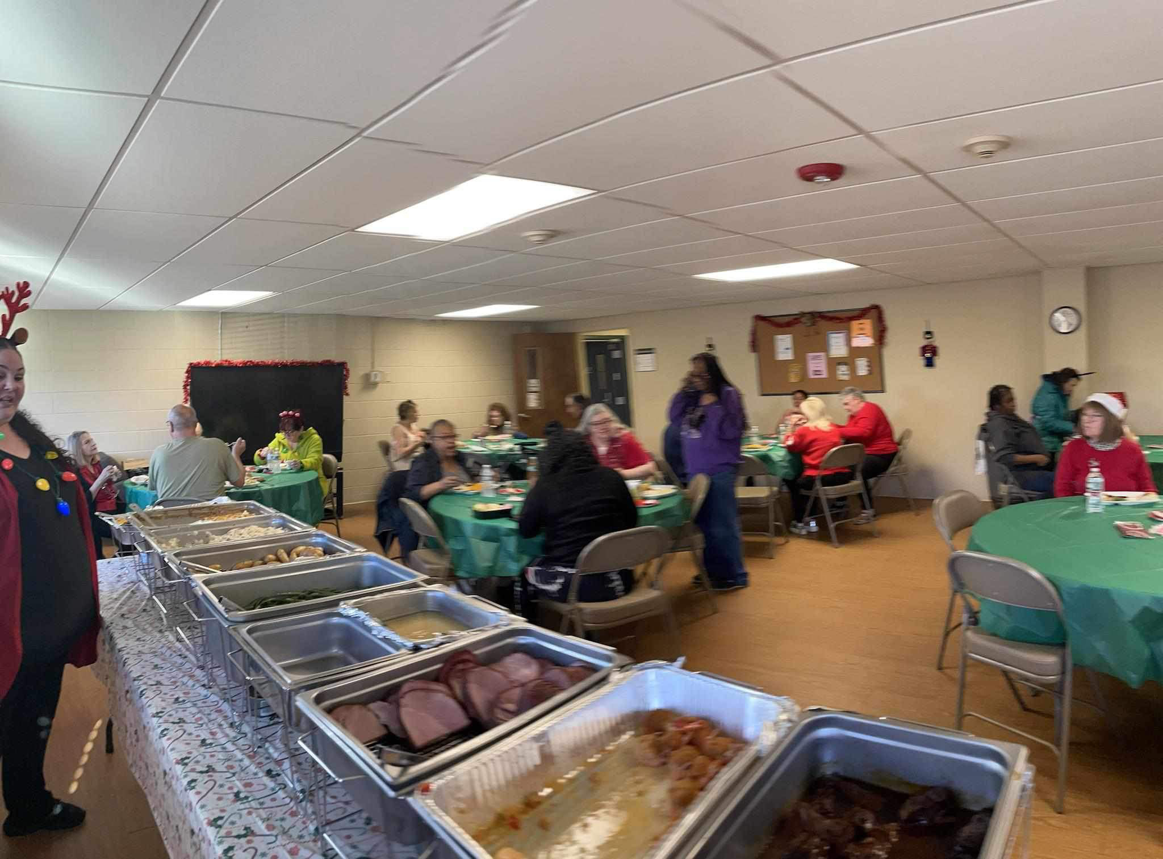
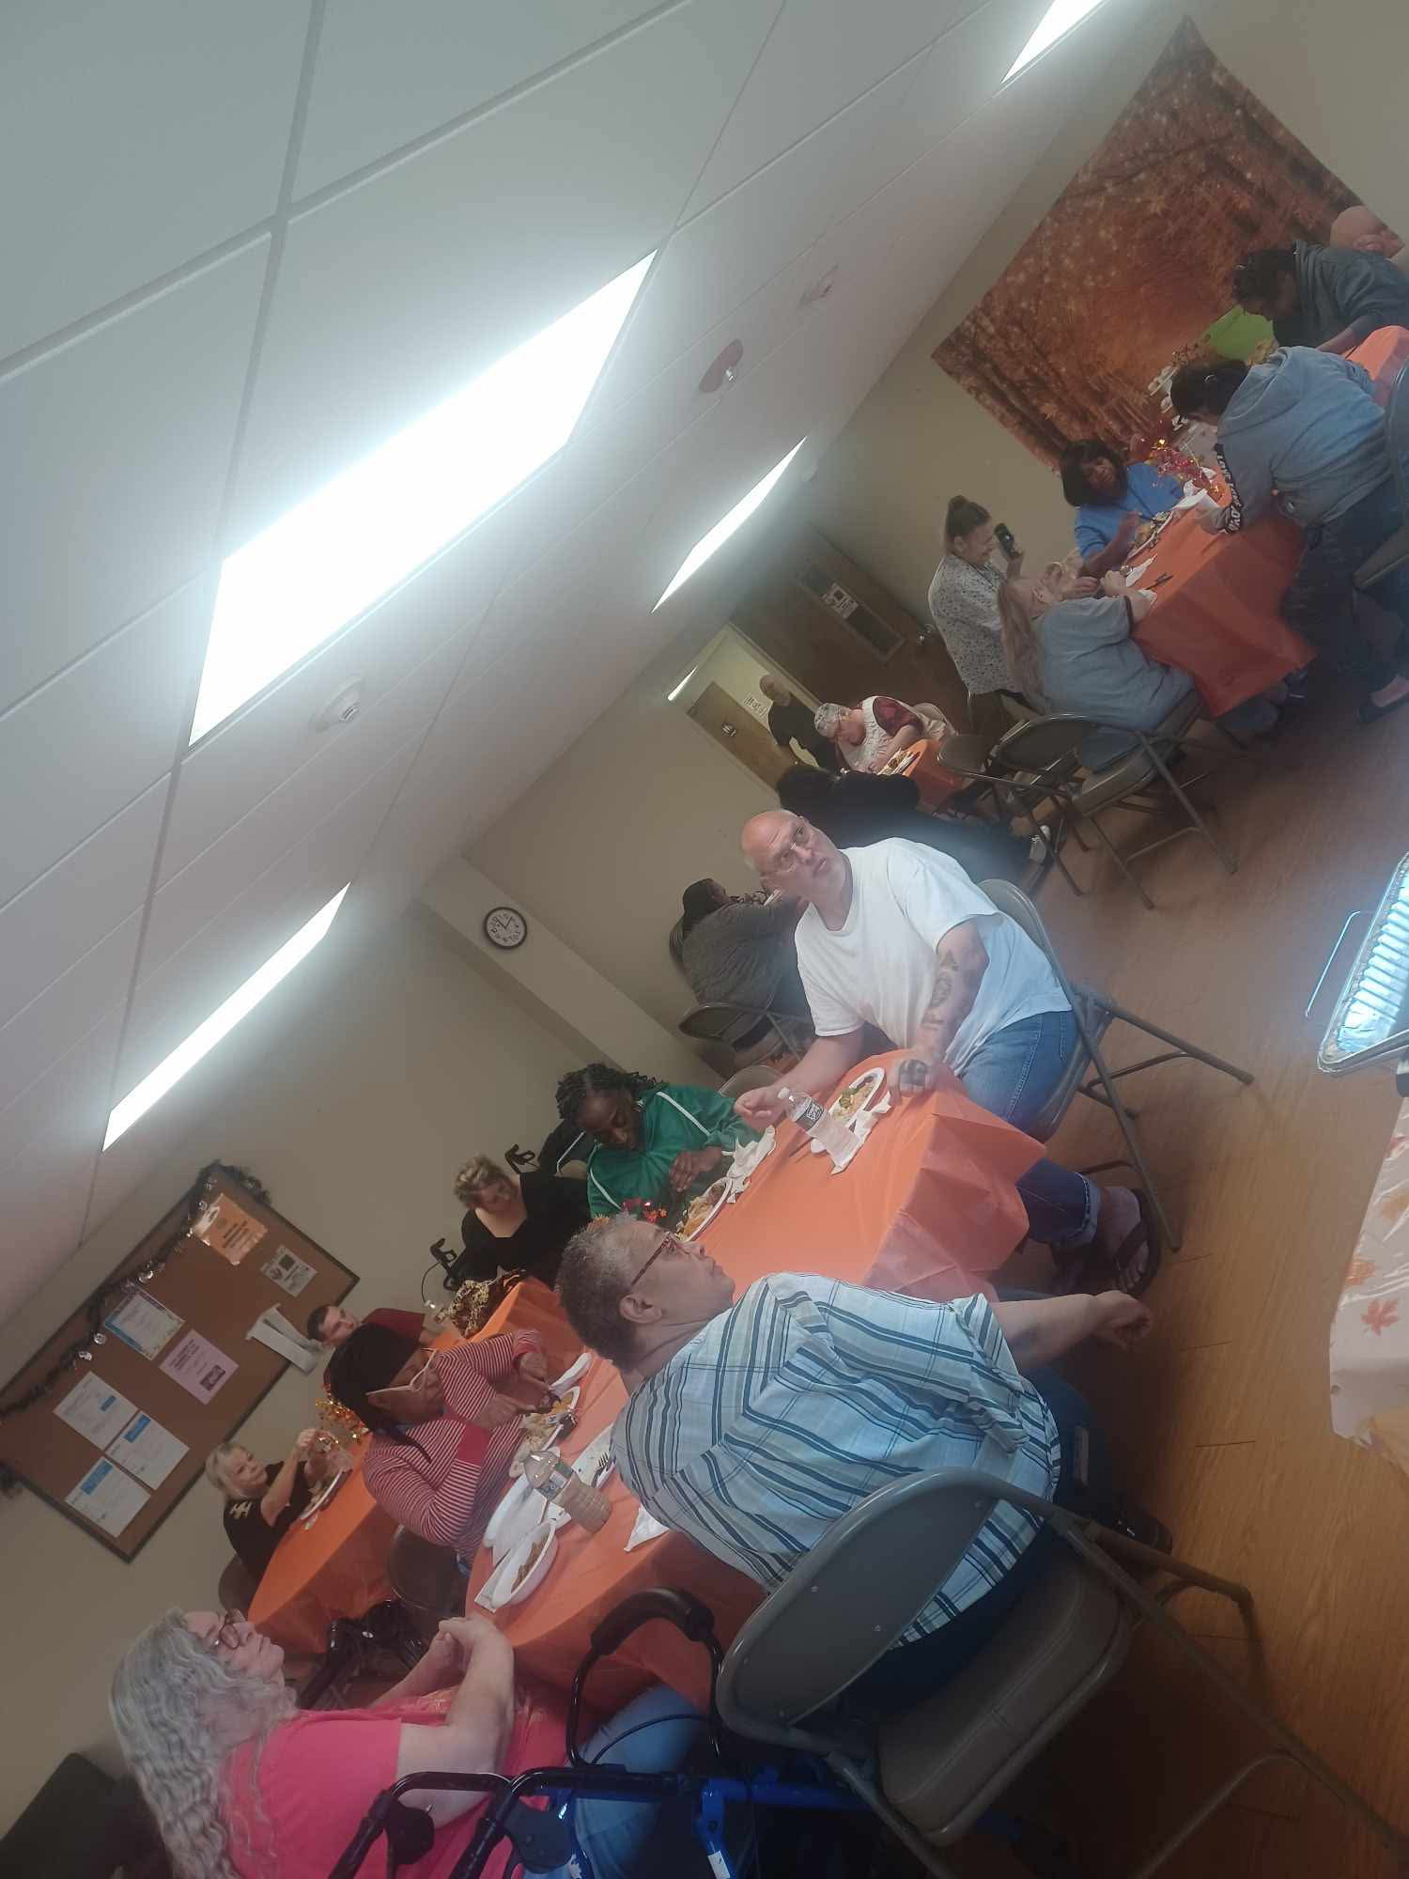
Resident Service Coordinators at Wingate not only support their residents in navigating systems and addressing SDoH needs but they also create social environments to promote community and tackle social isolation.
Strategies used by RSC at Wingate
Made one of it's elderly/disabled building a food pantry to address food insecurity with residents
Made connections with community partners to receive donations ( example incontinence products)
Monthly community gatherings including
Holiday celebrations
Exercise (Chair yoga w/ BCBS, Zumba, etc.)
Invite in Community Partners
Health Insurance partners
Local faith leaders
Annual Fire Safety Prevention
Educational sessions
And more

Slide 13
Notes:
https://chwari.org/walking-group-for-cranston-residents/
Sal created this need because he saw that the elderly population needed to exercise but had no one to do it with, so he created a walking group that has evolved into a community walk

Slide 14
Resources & supports
Notes:
https://agefriendlyri.org/about/our-work-groups/ - sign up for newsletter
https://www.rimeals.org/
https://prideinagingri.org/who-we-are
https://oha.ri.gov/point
https://oha.ri.gov/digiAGE

Slide 15
TRANSPORTATION SUPPORTS
Example
Warwick – Transwick Senior Transportation
Offers services to residents 55+ and adults with disabilities living independently
Weekly grocery shopping
Pharmacy, health screenings
Social service program and Warwick Senior Center
All recreational & educational programs at the city's senior & community centers
Banking
Other trips
Notes:
https://eohhs.ri.gov/sites/g/files/xkgbur226/files/Portals/0/Uploads/Documents/NEMT/FAQ-Elderly-Transportation-Program-2019-01-02.pdf
https://www.ripta.com/reducedfare/

Slide 16
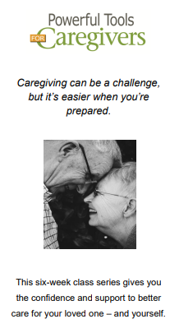
Resources & supports
Notes:
https://rielderinfo.com/advocacy-assistance/
https://web.uri.edu/olli/programs/fall-2024/
https://dioceseofprovidence.org/elder-services
https://www.cdc.gov/physical-activity-basics/guidelines/older-adults.html
https://www.aarp.org/caregiving/

Slide 17
RI CHW Older adult LANDSCAPE
Current Strengths
CHWARI Older Adults Endorsement
RIDOH awarded $600,000 federal grant to expand fall prevention programs. Initiatives will be rolled out in Woonsocket, Providence, & East Providence.
In partnership w/ local housing authorities & will fund evidence-based programs like
A Matter of Balance
Tai Ji Quan: Moving for Better Balance
Current Challenges
Social Isolation
Provider/Caregiver fatigue/burnout
Navigating dementia and mental health
Please share other challenges via chat
What are some of the unmet needs/challenges for this community?
What are some current strengths for this community?
How have you addressed any of the listed challenges?
How can we help address the needs of this community ?
Who can we join with to take action?

Slide 18
Upcoming opportunities
Advocacy opportunities
Learning
opportunities
Age-Friendly RI Workgroups
Civic Engagement
Economic Security
Food & Nutrition
Housing
Transportation and more
RI Citizens Commission for the Safety & Care of the Elderly – No update since 2022 on RI Secretary of State website
Providence Diocese – Powerful Tools for Caregivers class
TRAIN.ORG - over 200 trainings
National Health Care for the Homeless Council trainings
MHP Salud
National CHW Training Center
Notes:
https://agefriendlyri.org/about/our-work-groups/
https://dioceseofprovidence.org/elder-services
https://www.train.org/main/course/1093802/details
https://opengov.sos.ri.gov/OpenMeetingsPublic/OpenMeetingDashboard?subtopmenuId=201&EntityID=1054
https://nhchc.org/research/publications/chws/training-chws/
https://mhpsalud.org/community-health-worker-resources/older-adults/
https://nchwtc.tamhsc.edu/
https://opengov.sos.ri.gov/OpenMeetingsPublic/OpenMeetingDashboard?subtopmenuId=201&EntityID=1054

Slide 19
Thank you & take care of yourselves

