Slide 1
Activity
In your own words, what is Community Engaged Research? Why is it important?
Write down your thoughts and be ready to share!

Slide 2
Empowering Community Voices in Research
Panel Moderated by Tammy Thorson, MS
June 26, 2025

Slide 3
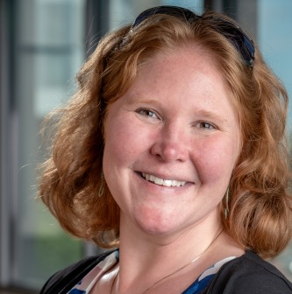
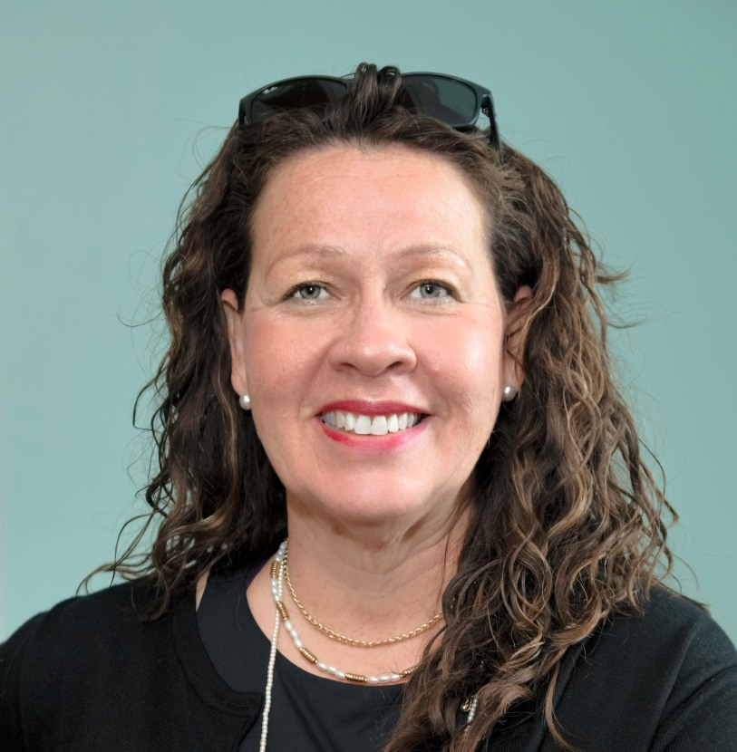
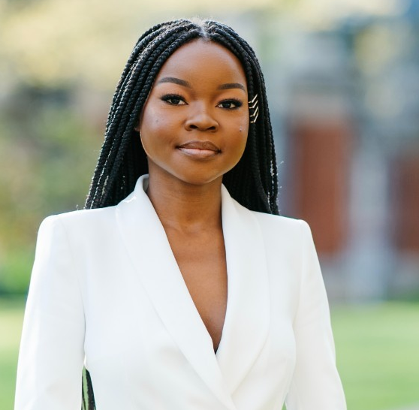
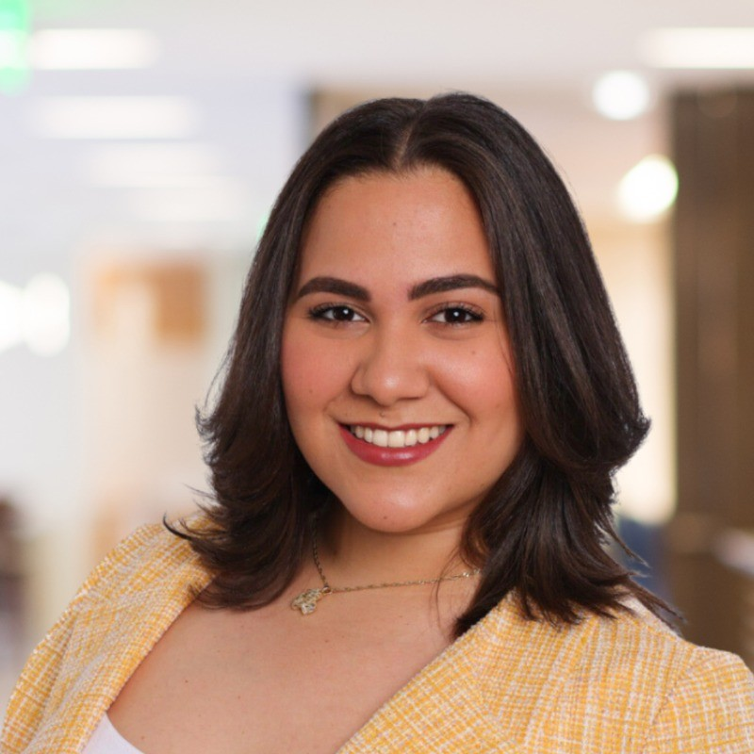
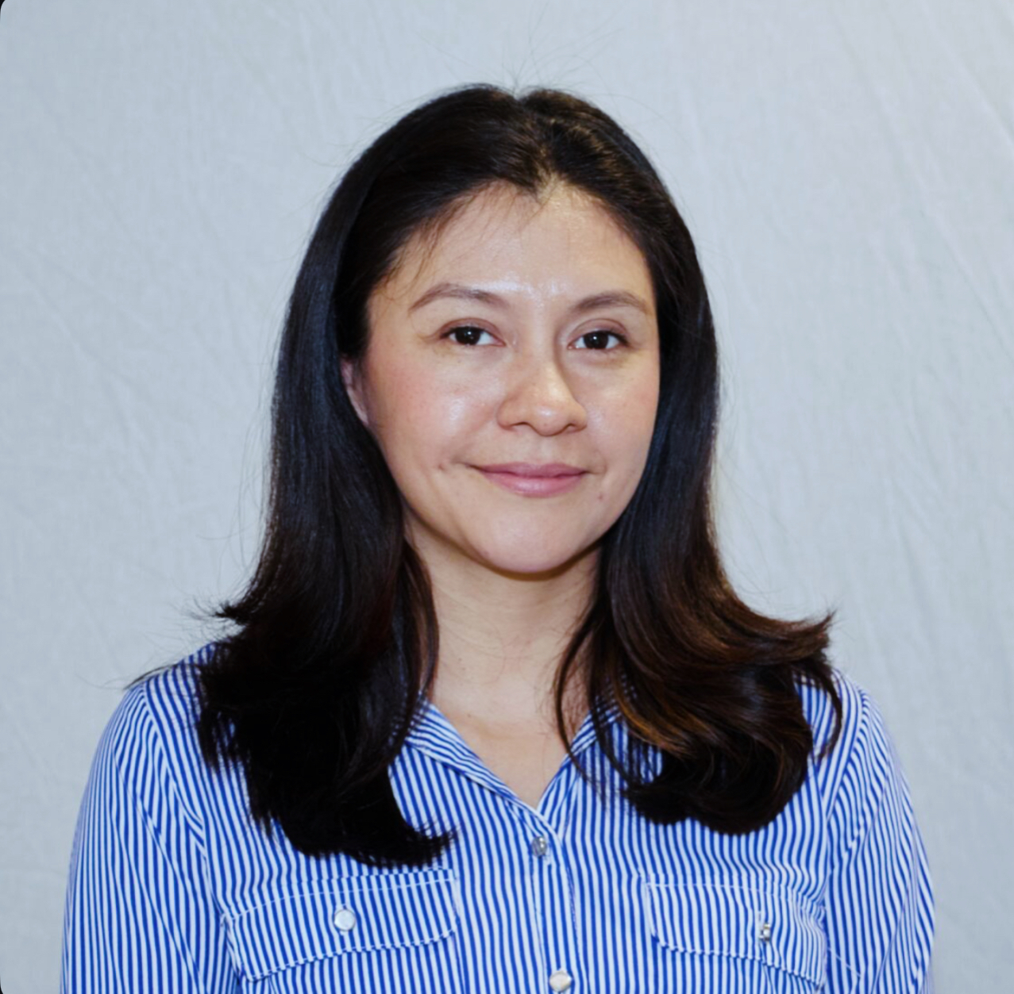
Our Speakers
Tammy Thorson, MS
Project Manager
Community Engagement and Outreach Core
Advance CTR Brown University
Hilda R. Castillo
Community Engagement Specialist
Advance CTR Brown University
Mitchelle Abuna, ScM
Sr Public Health Epidemiologist
RI Department of Health
Denisses Cortorreal
Research Community Liaison
Women & Infants Hospital
Dilenia Cruz
CHW & Lifestyle Coach
Progreso Latino
Emelin Cruz
Community Health Worker
Brown University

Slide 4
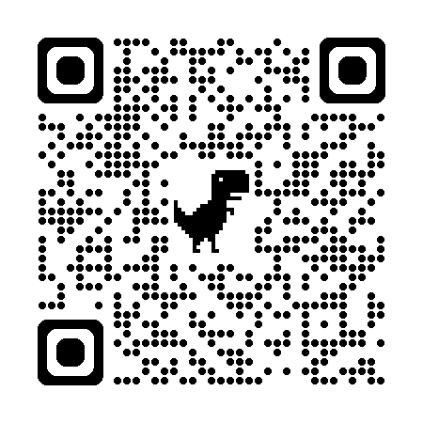
Scan QR code to take the learning course: Advancing Research Best Practices

Slide 5






Thank you!
Cite: U54GM115677
AdvanceCTR.org

Slide 6

Notes:
Poll Title: Do not modify the notes in this section to avoid tampering with the Poll Everywhere activity. More info at polleverywhere.com/support In a single word what was your take away from todays sesssion? https://www.polleverywhere.com/free_text_polls/nonyxDzaTd1C089MXetjZ

