Slide 1

RI Community Health Worker (CHW) Conference: Building Bridges: Strengthening Communities and Advancing Systems Together
Cultural Connections in Action:
CHWs and CLAS Standards
Rhode Island's Community Health Workers:
Your bridge to better health
Trabajadores comunitarios de salud de Rhode Island: Su puente hacia una menor salud

Slide 2


An Overview of the National Standards for Culturally and Linguistically Appropriate Services (CLAS) :
Understanding Policy and Practice
Developed by: The Network for Public Health Law
September 2023
Notes:
Welcome everyone, I am [name] from [organization name] and am excited to be here today to talk about the CLAS standards.
Thank you everyone for attending this training. This was developed in collaboration with the Network for Public Health Law. Referenced here. This collaboration is a new initiative that RIDOH took on in modifying CLAS trainings.
We know that there is a deep need and desire to understand what the CLAS Standards are and how to operationalize them so that they are more than just words on paper
This training is designed to do just that.
Let’s get started

Slide 3
Objectives
Understand the CLAS standards: development and components
Review the legal basis for CLAS Standards
Implementation: barriers and initiatives in advancing CLAS standards within your organization and for the community you serve
Understand the CLAS standards in practice through applied learning
Notes:
Today's objectives are...
READ SLIDE

Slide 4
Understanding the National Standards for CLAS:
Development and Components
Notes:
As many of you may have learned about CLAS before, today's training will dive into some more detail

Slide 5
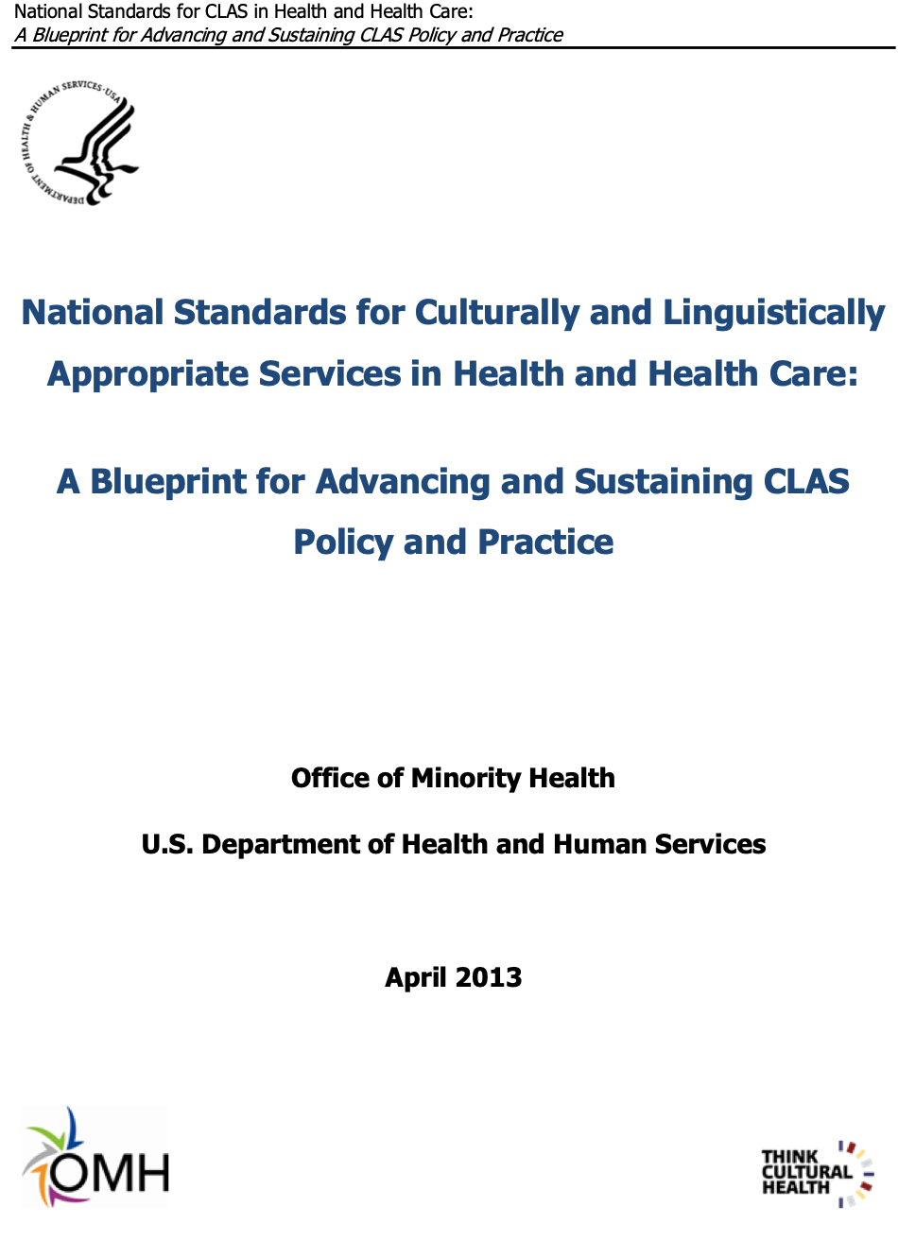
About CLAS
The U.S. Department of Health and Human Services Office of Minority Health (OMH) developed the CLAS Standards to assist health and health care organizations
Achieve health equity
Enhance quality of care
Eliminate health disparities
The CLAS Standards were updated in 2013 to, among other things, better center health equity.
Notes:
What are the National Standards for Culturally and Linguistically Appropriate Services (CLAS) in Health and Health Care?
First, when it comes to public health, communities of color and communities with limited English proficiency are routinely underserved by health care, governments, and other institutions on multiple levels
The good news is that many of these outcomes are the direct result of social and political conditions – which means they can be reformed
Read Slide.

Slide 6
CLAS Standards Overview
Principle Standard (#1): This is the umbrella standard that applies to all the other standards
"Provide effective, equitable, understandable, and respectful quality of care and services that are responsive to diverse cultural health beliefs and practices, preferred languages, health literacy, and other communication needs."
Governance, Leadership and Workforce (#2-4) | Communication and Language Assistance (#5-8) | Engagement, Continuous Improvement, and Accountability (#9-15)
These standards are directed at ensuring institutional support for the CLAS standards through resource allocation, diverse governance, and training. | These are directed at frontline practices for those working directly with communities, but also require support via 2-4. | These are directed at ensuring that there are policies and procedures in place to understand what is working and what needs work.
Notes:
There are 15 class standards divided into four general categories. The full list has been provided for you as a resource. You can refer to that.
The Principle Standard: is an umbrella standard that guides all of the other standards. This means it is the driving force, which is to [read standard 1]
The remaining standards are divided into three general categories
Governance, leadership, and workforce (read slide)
Communication and language assistance (read slide)
Engagement, continuous improvement, and accountability (read slide)
(The Rhode Island Department of Health has developed a training on the Communication and Language Assistance standards that primarily focuses on language services. This is a great resource for people to check out if they are interested in further learning about these standards.)
Luckily, there are a lot of resources out there. We will turn to a couple of examples of implementing actions to start to build a picture of what CLAS Standards in practice might look like.

Slide 7
Social Determinants of Health and Health Disparities in RI
Air Pollution
Linguistic Isolation
In Providence County, a third of residents do not speak English as their primary language.
In Providence communities of color living on low-incomes experience disproportionate exposure to carbon pollution and its health impacts.
In at least three zip codes in the area, 1 in 4 reported either not speaking English very well or not living in a household with adults who speak English very well.
The City of Providence, Providence’s Climate Justice Plan (2019)​
Hospital Association of Rhode Island, 2022 Community Health Needs Assessment​
Notes:
I want to turn our attention to some bigger picture information on why the Standards are important.
Only a small portion of health is impacted by clinical care, we know that the Social Determinants of Health, the conditions in which people live, work, and play, are highly determinative of health outcomes.
As in other places, inequities in the SDOH in RI are based on factors such as race, ethnicity, and national origin (which includes language)
On this slide are two examples:
Read first bullet (air pollution)
Read second bullet (linguistic isolation)
Importantly, linguistic isolation – can add to social isolation, which contributes to multiple negative physical and mental health impacts
References:
Air Pollution https://www.providenceri.gov/wp-content/uploads/2019/10/Climate-Justice-Plan-Report-FINAL-English-1.pdf
Linguistic Isolation https://d3egnnukzendc6.cloudfront.net/documents/HARI-2022-CHNA-Final-Report.pdf

Slide 8
Non-English Languages Spoken by LEP in RI
Non-English-Speaking Languages | % of Total State Population
Spanish | 5.17%
Portuguese | 1.07%
Haitian Creole | 0.33%
Khmer | 0.21%
French (incl. Cajun) | 0.16%
Italian | 0.13%
Thai, Lao, or other Tai-Kadai languages | 0.12%
Arabic | 0.12%
All other Non-English Languages | 0.71%
Total LEP | 8.35%
Portuguese, 13%​
Spanish, 62%
(*resource specifies Haitian) Rhode Island Division of Statewide Planning, 2022 Limited English Proficiency Plan, available at https://planning.ri.gov/sites/g/files/xkgbur826/files/2022-05/LEP%20Plan_04_27_2022_CLEAN.pdf
Notes:
Linguistic isolation in RI highlights the need for CLAS in the state. In RI, we have both non-English speaking populations and low-English proficiency or LEP populations.
The pie chart and table here are a snapshot of langs in RI.
I. The table next to it lets you know what percent of the total state population speaks the languages so that you can get an idea of where these communities fit into the larger RI picture
It is important to keep in mind though that these numbers represent the LEP population state-wide; and do not capture all languages spoken in the state
For example, Cape Verdean Creole is widely spoken in some areas of the state but is not individually mentioned in this report. It may be lumped in with the general Portuguese speakers despite the fact that it is a distinct language with important differences.
The top three languages can change depending on where you are in the state – thus community need for language access is not a one size fits all undertaking; you may for example be serving a community with a large population of people who speak Arabic so the translation needs here would differ than if you were just using the state demographic info
It is also important to keep in mind the needs of LEP populations with limited literacy, and cultures with oral languages or who prefer oral to written communications.
https://planning.ri.gov/sites/g/files/xkgbur826/files/2022-05/LEP%20Plan_04_27_2022_CLEAN.pdf

Slide 9
How Can A Failure to Meet CLAS Standards Impact Health Equity and Quality of Services?
People with limited English proficiency have been denied services due to the failure to provide interpreters.
Some LEP people are routinely denied care because entities refuse to admit them into in-patient treatment due to lack of interpretation services.
When facilities fail to provide accessible and culturally relevant communications individuals avoid seeking care.
People and family members of people who are undocumented may avoid facilities because there has been no communication on whether there will be negative immigration consequences (e.g., will Immigrations and Customs Enforcement be present?) .
Notes:
We often get asked: How Can A Failure to Meet CLAS Standards Impact Health Equity and Quality of Services?
It’s important to have a concrete understanding of some of the impacts on populations who have different cultural and language needs from the majority of the population
For example – [examples on slides]

Slide 10
The Legal Basis for the CLAS Standards
Notes:
In that vein, we will be discussing our next objective which is the legal basis for these standards.

Slide 11
Is there a federal requirement for CLAS implementation?
There is no federal requirement for implementation of CLAS Standards
But complying with CLAS Standards ensures compliance with relevant Federal law
Implementation varies by state
Notes:
There is currently no federal legislation or administrative regulation requiring implementation of the CLAS Standards.
Therefore, Implementation of CLAS Standards varies state by state.
Though there is not a federal requirement to implement the CLAS Standards, there are federal laws and policies that have bearing on implementation of the CLAS Standards.
Complying with CLAS Standards ensures compliance with relevant Federal law.
For this portion of the training, we will have a quick overview of some relevant Federal laws when discussing CLAS Standards, some relevant state laws, and go over some enforcement examples from the U.S. Dept. of Health and Human Services’ Office of Civil Rights.

Slide 12
Relevant Federal Laws
There are several relevant federal laws but the key laws are:
Title VI of the Civil Rights Act of 1964
Executive Order 13166 - Improving Access to Services for Persons with Limited English Proficiency
Section 1557 of the Affordable Care Act of 2010
Americans with Disabilities Act of 1990
Notes:
There are several relevant federal laws, but I want to highlight three of important ones
Title VI: Of these Federal laws, one of the most significant to be aware of is Title VI of the Civil Rights Act of 1964.
Title VI prohibits intentional discrimination based on race, color, or national origin in programs and activities that receive Federal financial assistance, and most funding agencies have regulations implementing Title VI that prohibits practices that could have the effect of discrimination.
Executive Order 13166 "Improving Access to Services for Persons with Limited English Proficiency" stemmed from Title VI of the Civil Right Act. It was rescinded on March 1, 2025 after Trump signed an EO declaring English as the official language of the US.
EO 13166 was significant because it clarified and reinforced existing legal obligations under Title VI of the Civil Rights Act of 1964. EO 13166 made it clear that failing to provide language access could be considered a form of national origin discrimination. It also required federal agencies to develop language access plans and ensured compliance from all federally funded programs.
Section 1557 of the Affordable Care Act of 2010 this also prohibits discrimination based on race, color, national origin, sex, age, or disability in certain health programs and activities. It requires hospitals and healthcare providers to offer language assistance to LEP patients. It prohibits discrimination in healthcare programs that receive federal funding. It includes language access requirements, ensuring that LEP individuals have meaningful access to healthcare services.
The rescission of Executive Order 13166 could create significant barriers for millions of LEP individuals seeking healthcare, social services, education, and legal protections. While Title VI and the ACA still offer some safeguards, their enforcement may weaken, making it harder for non-English speakers to access essential services.
ADA: As you may already know, the Americans with Disabilities Act (ADA) protects people from discrimination based on a physical or mental disability, and among other things requires governmental entities and places of public accommodation to provide effective communication

Slide 13
Title VI of the Civil Rights Act of 1964
Title VI of the Civil Rights Act of 1964 protects people from discrimination based on race, color or national origin in programs or activities that receive Federal financial assistance.
Delay in care due to lack of appropriate interpreter
Violation of Title VI can be:
Lacking a Language Access Plan for LEP
Lack of training plan within organization
Using untrained interpreters
Treatment without patients informed consent (invalid without a translator for LEP individuals)
Notes:
To be more specific...
Reference/read slide:
Title 6 of Civil rights act of 1964
Limited English Proficient Population

Slide 14
Relevant Rhode Island Law
There are many relevant laws. Here are a few highlights:
R.I. SB 0678
Proposed legislation for cultural competency training for doulas.
R.I.G.L. § 23-64.1
The Rhode Island Commission for Health Advocacy and Equity (CHAE).
R.I.G.L. § 23-17-54
Interpretation and language requirements for hospitals and emergency care facilities.
Notes:
There are other relevant laws regarding language services in health care settings, including a requirement for interpretation for informed consent for abortion services for a pregnant person who does not understand English.
Further, under Rhode Island General Law, all hospitals and emergency care facilities:
Must provide a qualified interpreter, and
Must post multilingual notices for, at minimum, the top three most commonly spoken languages other than English.
Rhode Island law also requires that the Department of Human Services provide enhanced services, including interpreter services, to pregnant persons eligible for Medicaid.
The R.I. Commission for Health Advocacy & Equity was created in 2011 and is empowered to advocate for the integration of activities to help achieve health equity, to advise the Governor, General Assembly, and the Rhode Island Department of Health on racial, ethnic, cultural, and socioeconomic health disparities (issues pertaining to health equity).
And, of course, the R.I. Dept. of Health receives CLAS Standards-related complaints, for example involving communication barriers or incidences of cultural insensitivity.

Slide 15
Relevant Department Regulations
There are many relevant department regulations. Here are a few highlights:
216-RICR-40-10-25.4.5(C)
Harm reduction centers must provide language assistance for clients who do not communicate using English.
216-RICR-50-05-1.7.6(C)(1)
Delivery of Public Drinking Water "public education materials must contain information in the appropriate language(s)…"
216-RICR-20-05-3.3(A)(23)
Nutrition Education is to be provided "in keeping with the individual's personal, cultural, and socioeconomic preferences."
Notes:
Several Rhode Island Department of Health Regulations relate back to the CLAS Standards. [read only first two examples]
For example, harm reduction centers in the state must provide language assistance for those who do not communicate using English.
For the WIC program, the definition of nutrition education emphasizes that it is all to be provided in keeping with an individual’s personal, cultural, and socioeconomic preference.
These are just a few examples.

Slide 16
Civil Rights Entities in Rhode Island
Investigates claims of discrimination
Rhode Island Commission for Human Rights
Department of Human Services Civil Rights Office
Education and outreach
Intake, investigation, and settlement of discrimination charges
Administrative hearings
Conducts compliance reviews
Provides trainings and guidance
Ensures that civil rights matters are addressed, whether pursued criminally or civilly
Office of the Attorney General Civil Rights team
Notes:
What about enforcement of laws that have been mentioned?
Several entities in the State of Rhode Island are charged with enforcing civil rights violations.
Read the name of the 3 entities and state "their charges are listed here."
[For longer presentations, read the bulletpoints on the slide]
These include:
The Rhode Island Commission for Human Rights, which specializes in antidiscrimination law enforcement.
The Department of Human Services which has a Civil Rights Office responsible for investigating claims of discrimination and also conducts compliance reviews of its offices, programs and contractors.
The Attorney General’s Office has a dedicated Civil Rights Team that addresses civil rights issues, which includes hate crimes and police misconduct, are addressed and pursued either criminally or civilly as applicable.
As stated earlier, the Department of Health specifically receives CLAS-Standards related complaints, which can be made through the website or by calling the RIDOH Health Information Line.

Slide 17


The Role of HHS Office for Civil Rights
OCR enforces Federal civil rights laws, conscience and religious freedom laws that, together, protect fundamental rights of nondiscrimination, conscience, religious freedom, and health information privacy.
OCR conducts compliance reviews and investigates complaints.
The most common complaints relate to communication barriers.
Notes:
In addition to the state entities named previously, the U.S. Dept of HHS’s Office of Civil Rights performs compliance reviews and investigates the complaints it receives.
Even though the CLAS Standards are not required to be implemented by law, compliance with the CLAS Standards ensures compliance with relevant Federal law, such as Title VI and the ADA.
Many complaints at the OCR that connect to the CLAS Standards appear to relate to communication barriers.
The CLAS standards, however, also encompass cultural diversity and diverse cultural health beliefs and practices.

Slide 18
Share CLAS Concerns and/or Complaints
Related to people experiencing lack of access, barriers to care, cultural insensitivity, concern for unfair treatment, due to:
Language
Ethnicity or race
Sexual orientation
Sex, gender, and gender expression
Gender Identity
Religion/faith
Disability Status
Literacy status
RIDOH Customer Service/Complaint Line 401-222-5960
Notes:
In a situation where you or someone you know would like to submit a formal complaint because : lack of access, barriers to care, cultural insensitivity, concern for unfair treatment, due to language or any other status or identity you may submit a complaint through the RIDOH complaint line.

Slide 19
Implementation
Barriers and Initiatives in Advancing CLAS Standards in the Workplace
Notes:
Now that we've reviewed the importance of CLAS standards, its components, and the legal basis for CLAS standards, we turn our attention to implementation. Before we move on to implementation and its challenges, do we have any questions?

Slide 20

What are some barriers to implementation of CLAS Standards that you experience within your organization?
Notes:
Consider barriers.
NOTE: allow time to share answers and allow participants to elaborate if they choose.

Slide 21



Implementation Challenges
“Funding and staff”​
“Financial, top down support”
“Timely translation, finances to support”
“Implementing the standards out in the field w/o access to translation services”
“Other than the translation form, I don't know what RIDOH CLAS resources are available or how to access them.”
“Funding for professional interpreters, inadequate knowledge of cultural/language resources needed, etc.” ​
“Internal processes for translation and capacity”​
“Funding constraints, human resources, vendor's compliance”
“Some departments might have financial or cultural barriers to providing effective communication and services.”
“I could imagine wait time for getting new materials approved for circulation.” ​​
“Profession requires English proficiency”
Select responses received from:
Leadership
Frontline Staff
Notes:
This slide shows a selection of responses received to the question you were just asked. Leadership responses in the blue boxes, and frontline are in orange.
Leadership responses were high-level and generalized; focused on affordability (i.e. "funding sources", "funding constraints") and adoption (lack of internal processes and staff resources), whereas frontline staff responses were more numerous and specific, focusing on barriers related to availability (or access ) and adoption.
Frontline staff did not bring up "financial" or "affordability" barriers not nearly as much as leadership.
Frontline staff responses heavily focused on adoption barriers - or the process-related barriers by which CLAS practices can be implemented, and the capacity that is necessary. Barriers related to not having the necessary information, support, and opportunities.
One response from a frontline staff person encapsulates these adoption-related barriers well, but isn't shown here due to length. They said: “During the pandemic, we had trouble with ensuring some of our digital/technological resources met certain standards. We, as one State agency, could address the individual resources in question, but need the whole state (or "Enterprise-wide") to establish and implement technology that meets these standards. Also, our purchasing processes (for services like interpretation and translation) are quite burdensome and slow (how can we better support our finance team to improve this process? I'm sure it's a nightmare for them, too!)”

Slide 22
Implementation Tips and Strategies
Why implement CLAS Standards?
Comply with the law
Ensure meaningful access to programs and services
Improve outcomes
Strengthen relationships – internal and external
Improve operations
Notes:
Here is the WHY!
There are several reasons why agencies should take an active approach to implementing the CLAS Standards. One of the most important reasons is to comply with the law, as you just heard about in the previous section.
Other reasons include improving programs and services to ensure meaningful access and a path to better outcomes.

Slide 23
General Implementation Tips
Implementation can be supported through:
Learning
Required vs. Optional
Ongoing practice and program-based in-service
Workforce recruitment and retention strategies
Posting jobs in multiple languages
Conducting a cultural audit of a program or organization
Expanding the recruitment base
Staffing
Community Health Workers
Cultural Brokers
Translators and Interpreters
Resources and Supports
Tools like “I Speak” or “Point and Speak” cards
In-person and telephonic interpretation services
Trained translators
Visit LEP.gov for more resources
Multilingual signage
Notes:
Here is the HOW!
NOW let's turn to how to implement . There are a number of ways to incorporate the CLAS Standards into operations.
Workforce recruitment and retention strategies, like where you post jobs and in what languages, are one example.
Another is to ensure that you have staff on your teams or incorporate staff on your teams who can help support implementation, like Community Health Workers, Cultural Brokers, and translators and interpreters.
As already noted and as you are all already doing, you should considering ongoing learning opportunities. These can be within a program or department or specific to a team, for example, by reviewing real examples that the team has encountered.
Finally, there are also resources available like "I Speak" or "Point and Speak" cards. These and other key resources and examples can be found at LEP.gov.

Slide 24
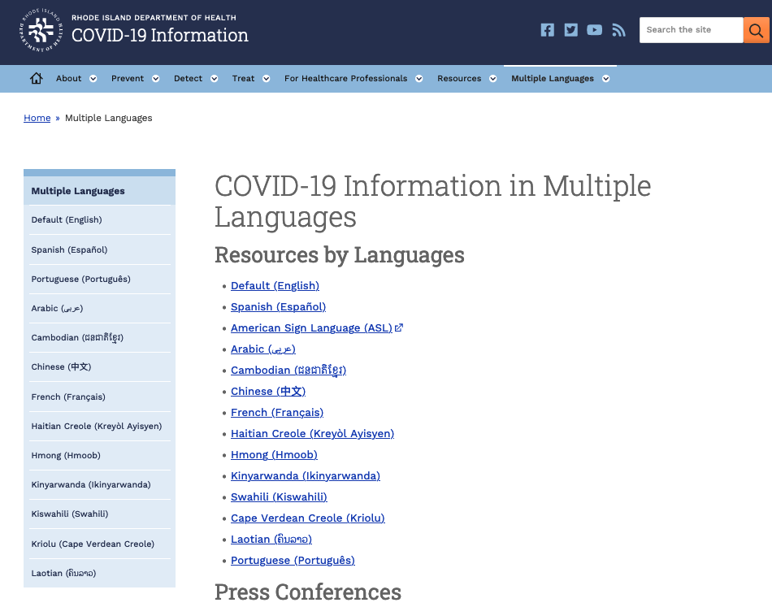
Example: COVID-19 Information
Notes:
While we're on the topic of the many language spoken in RI, one resource that I want to make sure the people are aware of is the RIDOH’s COVID-19 webpage, which has translated COVID-19 information in 14 languages including English.

Slide 25
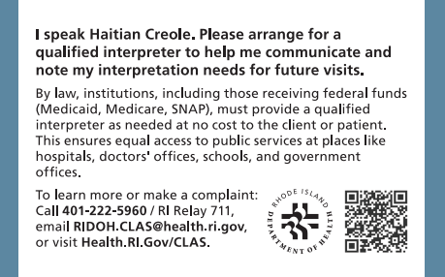
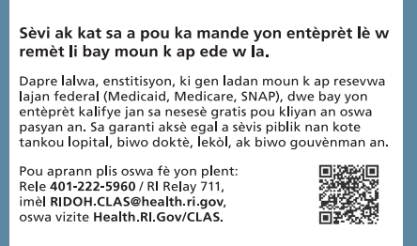
Example: "I speak.." Cards
These cards are available in 21 different languages currently.
Rhode Island Department of Health, CLAS Resources, https://health.ri.gov/equity/about/clas
Notes:
On this slide is an example of I Speak Cards created by the Rhode Island Department of Health. This card can be carried. The example here is Haitian Creole.
These wallet cards are available in 21 languages
There are also some tools that we can provide our clients
I-Speak Cards
I-Speak cards lets the health care staff know the client speaks a specific language and need an interpreter.
The wallet size cards come in English – for the person that is assisting the patient and provides the same information in the language that the patient prefers
The information on the card also lets the health provider or staff member know that they are required to provide qualified medical interpreter as needed.
Digital version of this card is available on our RIDOH CLAS web page in multiple languages. Many of the languages available include Spanish, Portuguese, Cape Verdean Creole, Chinese, French, Haitian Creole, Italian, Karen, Khmer, Kinyarwanda, Nepali, Portuguese, and Somali
Pass out I speak cards to audience
External Partners: You have access to online to the digital version of the cards. Connect with your organization about making the cards available to your patients/clients

Slide 26
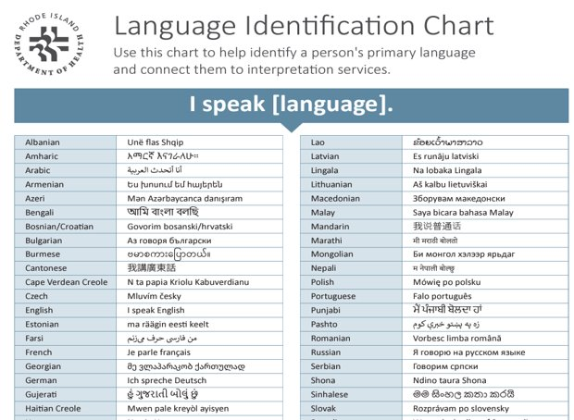
Example: Language Identification Charts
Rhode Island Department of Health, CLAS Resources, https://health.ri.gov/equity/about/clas
Notes:
Language Identification Chart is another tool that can be used.
These charts usually have over 2 dozen language that can help point to the prefer language of the patient needing care. Sometimes these are posted near the check in area at a health care facility.
You can also find a digital version of this card online to carry on your phone or print.
Language Identification Chart Language Identification Chart - refugeecouncil.org.uk/wp-content/uploads/2020/01/Language_ID_chart.pdf
USDA I Speak Statements Card | Food and Nutrition Service (usda.gov)

Slide 27
Implementation at All Stages
CLAS Standards should be
Integrated into your mission, vision, and values
Integrated into strategic plans and program plans
Implementation should be
Reviewed on a regular basis
Established during onboarding and reinforced through employee learning opportunities
Notes:
IMPORTANT CONSIDERATION FOR LEADERSHIP:
Incorporating the CLAS Standards into your mission, vision, and values as well as any planning documents demonstrates organizational commitment to culturally and linguistically appropriate services.
You should review how well you are doing with implementation on a regular basis – this could be quarterly or annually, for example.
New hires should learn about the CLAS Standards as part of orientation and all employees should engage in ongoing learning opportunities as part of an intentional approach to implementation.

Slide 28
Examples of Implementation from Other States
The New Mexico Department of Health partners with COPE (Community Outreach & Patient Empowerment)
The Massachusetts Department of Public Health Sexual Assault Prevention and Survivor Services Program
They work toward certifying all Navajo Nation Community Health Representatives as Community Health Workers through the Department’s voluntary certification program.
They maintain a Volunteer Language Bank to capture the language capacity of rape crisis centers providing services to the community.
Notes:
These are two examples of how CLAS Standards can be implemented.
The first is the New Mexico Department of Health, which partners with Community Outreach and Patient Empowerment to certify all Navajo Nation Community Health Representatives as Community Health Workers, in part to support integration of CHRs into care teams and collaboration with public health nurses.
The second example is from the Massachusetts Department of Public Health, Sexual Assault Prevention and Survivor Services Program that maintains a volunteer language bank to capture the language capacity of rape crisis centers.

Slide 29
Breakout Groups
Notes:
We've covered the importance of CLAS standards, its development and components, the legal basis for CLAS standards, and implementation, it's time to do some applied learning.
Before we go into breakout group, are there any questions?

Slide 30
Instructions
Review the scenario and discuss.
Identify someone to take notes (scribe) and a speaker to share one key observation or question from your group.
You may use the questions provided to guide your discussion.
Notes:
For the breakout groups we have provided a hypothetical scenario that addresses common issues that organizations face when implementing the CLAS Standards. You should already have this in your materials.
We will read through the scenario together as a group in a moment. But first let’s go over the logistics.
We are breaking everyone up into # of breakout groups for (10) minutes. Please identify someone to share one key observation or questions in the chat to share with the larger group when we get back. I will read observations or questions and then move on to our last section of today’s training.
[note: size of breakout groups will vary depending on size of audience]

Slide 31
Scenario
You are a Community Health Worker working in a neighborhood-based health program that connects individuals and families to essential health and social services.
One morning, while staffing your community resource center, a young adult client who does not speak English walks in. They appear distressed and need help navigating local health services. The client is accompanied by a friend who speaks both English and the client’s language. You begin by welcoming the client and rely on the friend to help interpret the conversation. At first, this seems to work. However, as you ask more detailed questions about the client’s needs, medications, and health history, it becomes clear that critical information is not being accurately conveyed. You start to worry about miscommunication and potential risks to the client’s well-being.
Notes:
Ask an audience member to volunteer to read this slide.

Slide 32
Discussion Qs:
In situations like the one in the scenario, what specific barriers have you seen non-English-speaking clients face when trying to access services or care?
How have you, as a CHW, helped bridge language or cultural gaps in real-life situations—especially when interpreter services weren't immediately available?
Thinking about your own work and community, what could we do better—together with community members—to ensure language access and culturally respectful care?
Questions
Notes:
In order to begin to understand how services can be culturally and linguistically appropriate, we must first define culture. How would you define culture? Feel free to speak up or type in the chat [pause and discuss answers].
Use a word cloud, if possible.

Slide 33

Report Out: What was your group’s one key observation or question?
Notes:
Read: What was your group’s one key observation or question?
Virtual: people can come off mute and share or share in chat
In-person: people can raise hands and share
NOTE: take up to 8 minutes to review what people share from their breakout groups and have some short discussion.
Q: Do participants know about how to access language line? Or what their protocol is for interpreter services?

Slide 34

Questions Regarding CLAS Standards?
NEW!!!
Email
RIDOH.CLAS@health.ri.gov

