Slide 1
Motivational Interviewing
A Compassionate Way of Being
June 26, 2025

Slide 2

Jacki Hecht, RN, MSN
Project Coordinator
Luci Baines Johnson and Ian J. Turpin
Center for Gerontological Nursing
UT Austin School of Nursing
jhecht@nursing.utexas.edu

Slide 3
https://cherylschirillo.com/2017/01/09/how-to-do-the-4-part-breathsquare-breathing/
Notes:
Practicing box breathing or deep breathing is a helpful way to focus your attention on the present moment and quieting distractions. It can also help you to set an intention for what you are trying to accomplish with your clients, so that you can help THEM focus on identifying their goals, values and what they want to achieve.

Slide 4
Main Goals of MI
Create a safe and trusting relationship/environment for patients to share openly,
2. To help patients explore their goals and ambivalence about change,
3. To help patients make more informed decisions about their choices,
4. To elicit “change talk” that promotes action towards patient goals and aspirations.

Slide 5
The Complexities of Behavior Change…
Think about a behavior you would like to change. When did you first start thinking about wanting to make this change?
2. Do you know of at least one thing you could do to begin to make this change?
3. If you were told that you must start making this change by the end of today… how likely is it that you would begin to change?
4. If you were offered 1 million dollars to start making this change by the end of today, how likely is it that that you would begin to change?

Slide 6

Ambivalence:
A normal part of the change process
I want to
I don’t want to

Slide 7


Your WHY is a deep-seated purpose, cause, or belief that is the source of your passion and inspiration.
Everyone has a WHY; the challenge is putting it into words. - Sinek
Living with purpose makes you healthier.
Notes:
Simon Sinek is an American author and inspirational speaker who focuses on business leadership. He's best known for popularizing the concept of finding your "WHY" in his 2009 TED Talk

Slide 8
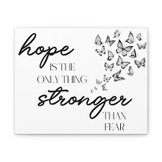

Hope is not just a feeling. It’s a way of thinking and believing.
When we feel hopeful, we are more likely to be motivated to pursue our goals. We have faith and energy to work towards success.

Slide 9
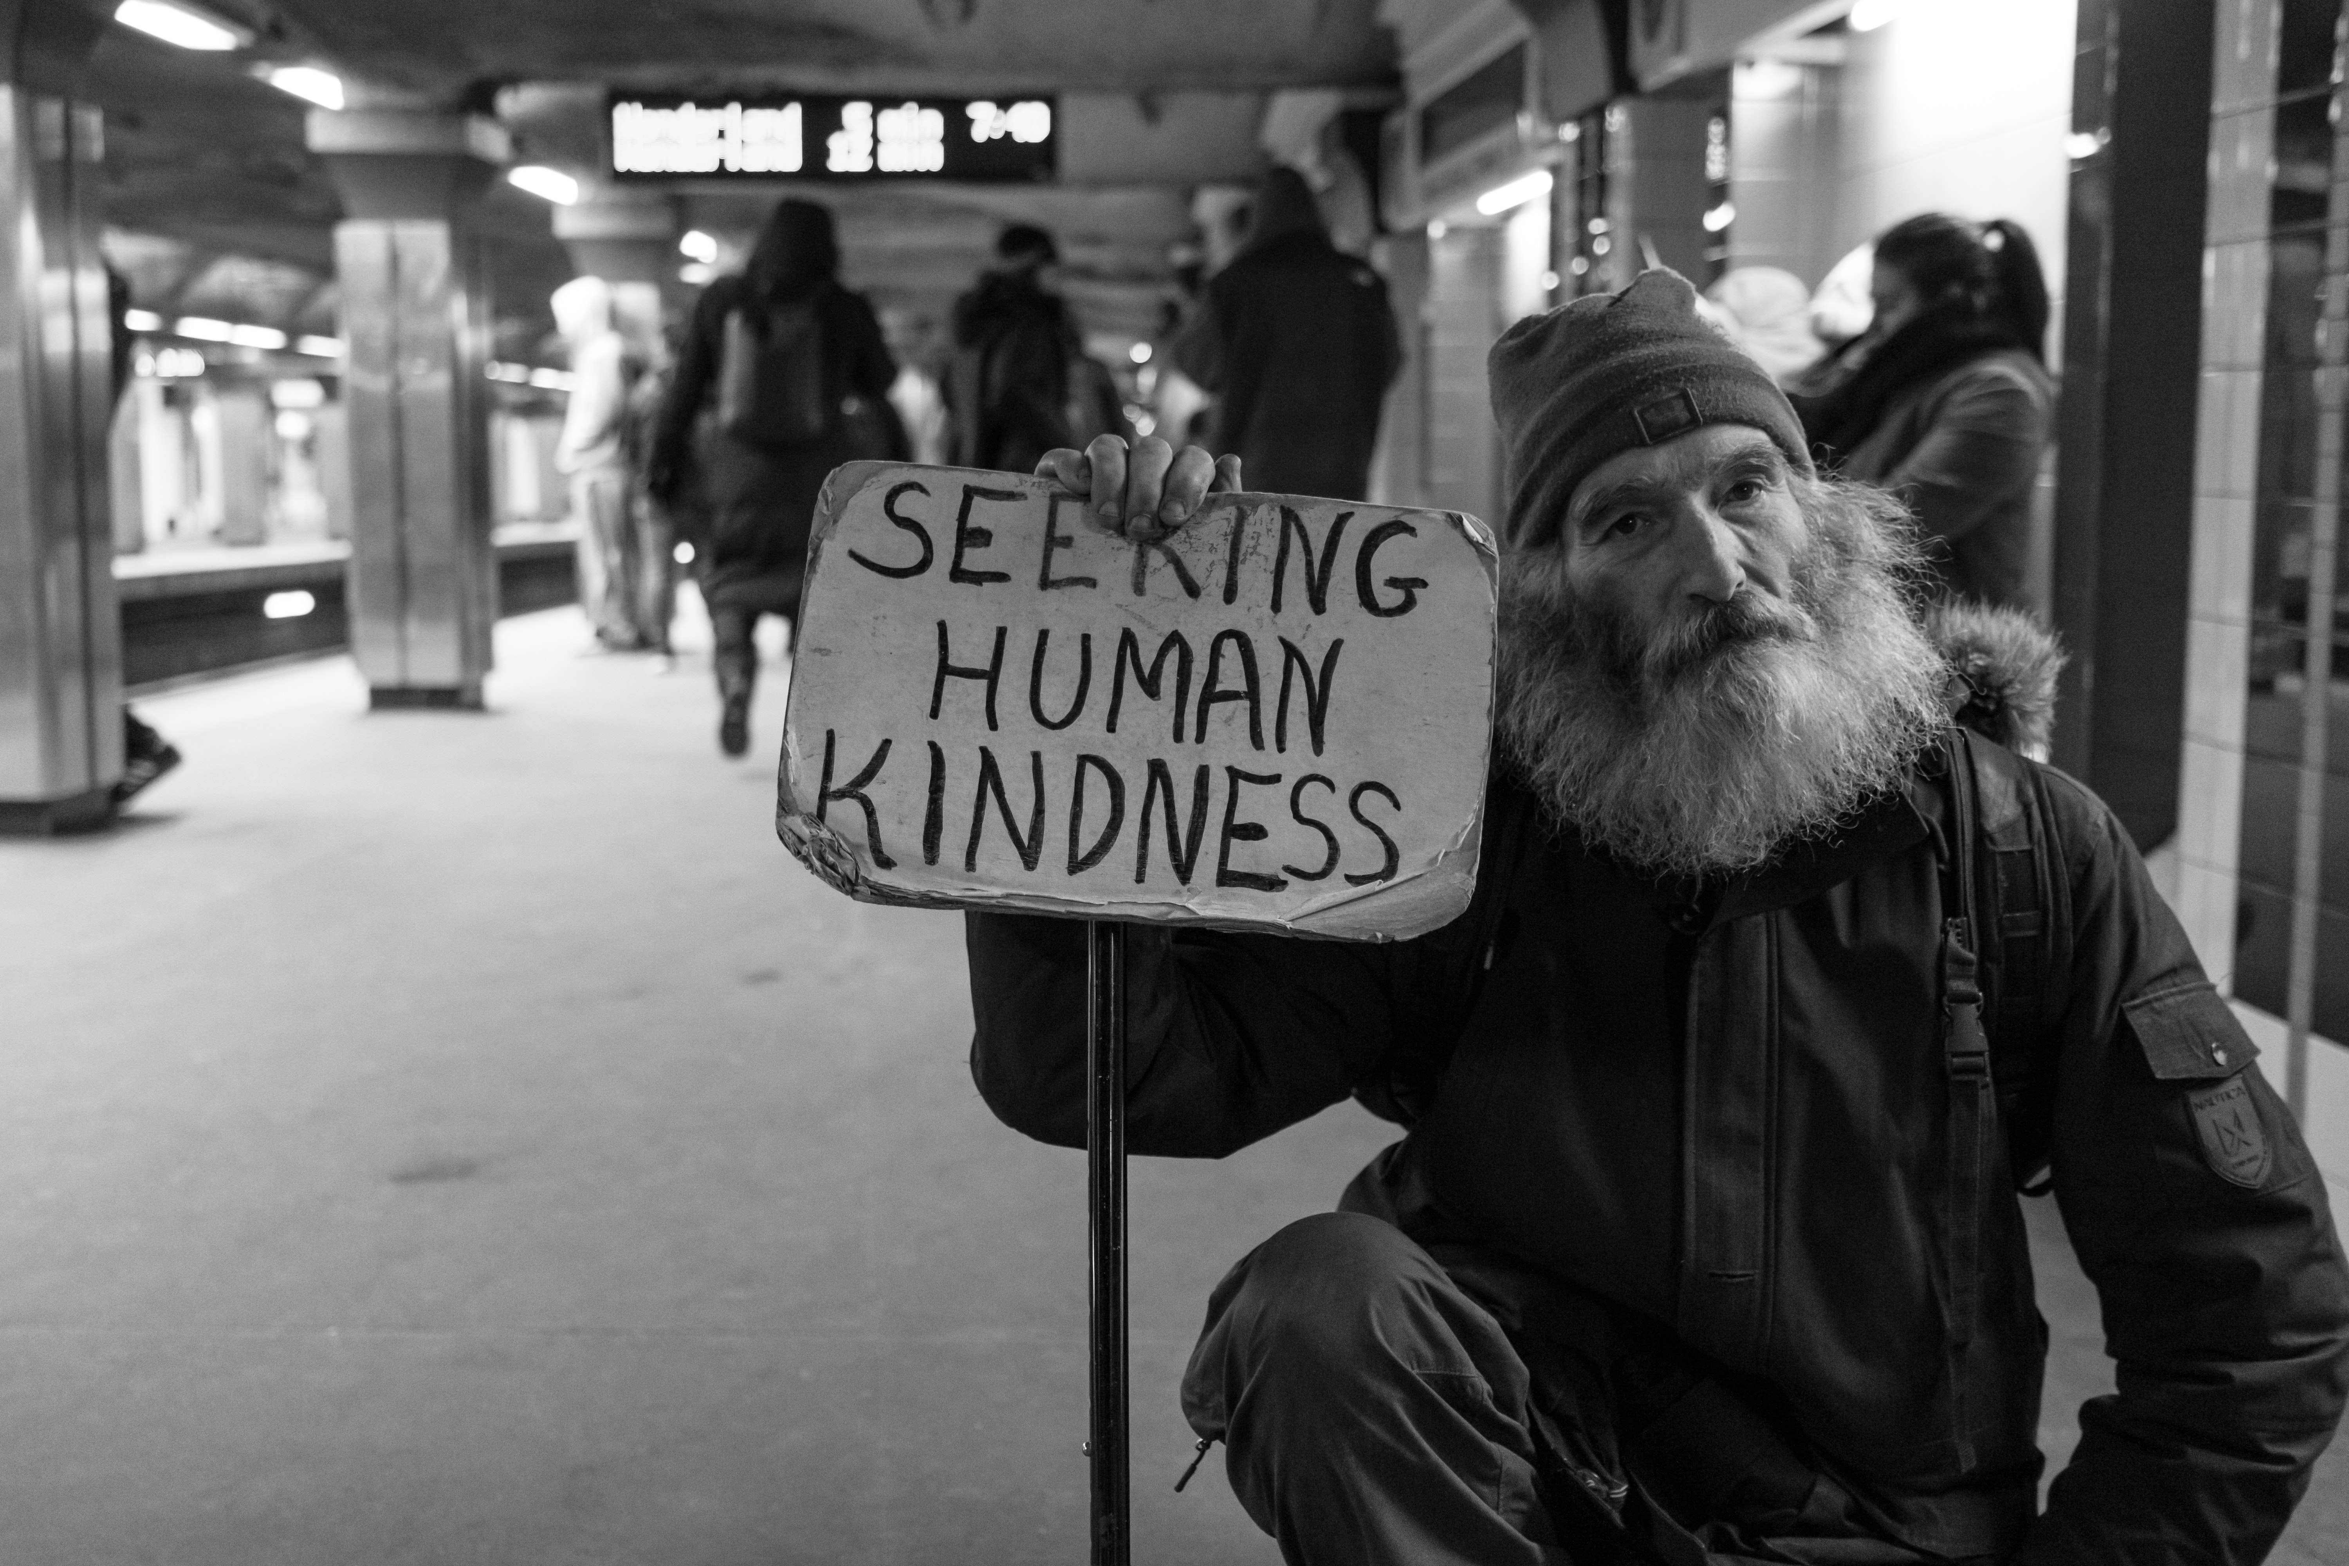
Engaging the Client with MI Spirit
Partnership
Acceptance
Compassion
Evocation

Slide 10
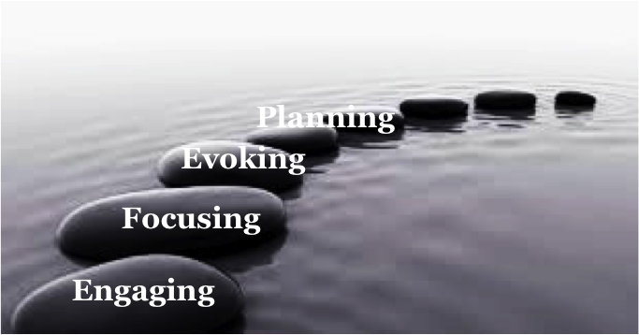
The Four Stepping-Stones (Processes)
How
Why

Slide 11
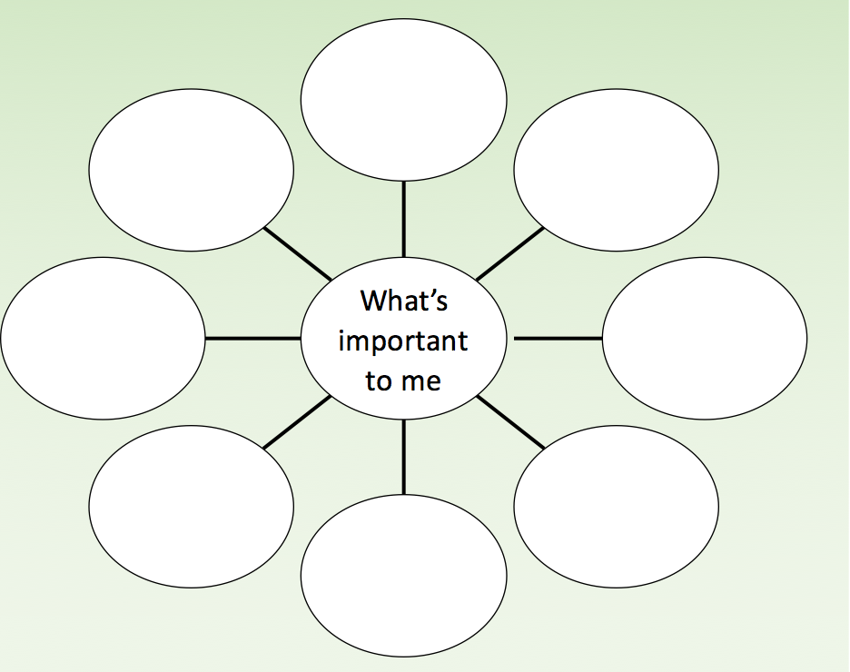
Engaging
Assess Client Values
Institute for Healthcare Improvement (2012)
https://montefiorehvc.org/what-matters-to-you/

Slide 12
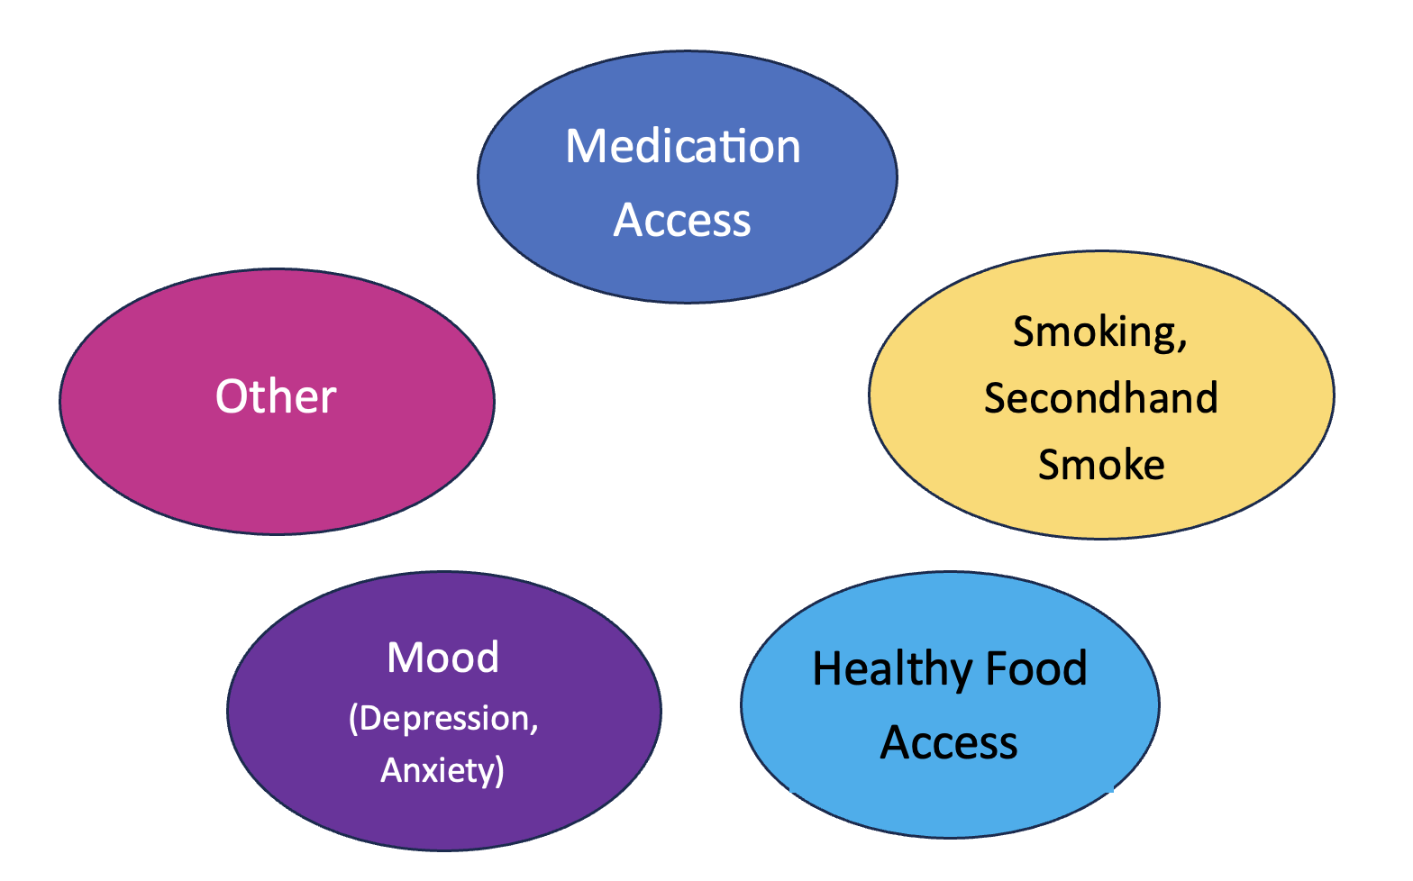
Focusing the Conversation
Agenda Setting

Slide 13
Evoking
Belief in the Client’s Capacity for Change
Looking and Listening for Clients’ Strengths
Nurturing the Client’s Internal Motivation

Slide 14

What are we listening for?
Preparatory Change Talk
DESIRE to change (I want to, would like, wish)
ABILITY to change (I can, could . . )
REASONS to change (it would help me to..)
NEED to change (I need to, have to, got to . .)

Slide 15

Mobilizing Change Talk
Signals moving beyond ambivalence
COMMITMENT (intention, decision, promise)
ACTIVATION (willing, ready, preparing)
TAKING STEPS (examples of actions taken)

Slide 16

O
A
R
S

Slide 17
OARS
Open Questions
Seek more information than “yes” or “no”
Affirmations
Highlight client’s strengths, determination or values
Reflective Listening
Verbalizing a guess at what the person means, with a statement
Summarizing
Statements link together and reinforce information discussed

Slide 18
Open Questions
CLOSED QUESTION
OPEN QUESTION
Don’t you want to get help right now?
Can’t you just stop smoking?
Would you like to learn more about asthma management?
Do you want to eat more healthfully?
What would be most helpful to you right now?
What are your thoughts about stopping smoking?
What information do you need about asthma management?
What might help you to eat more healthfully?

Slide 19

Reflections

Slide 20
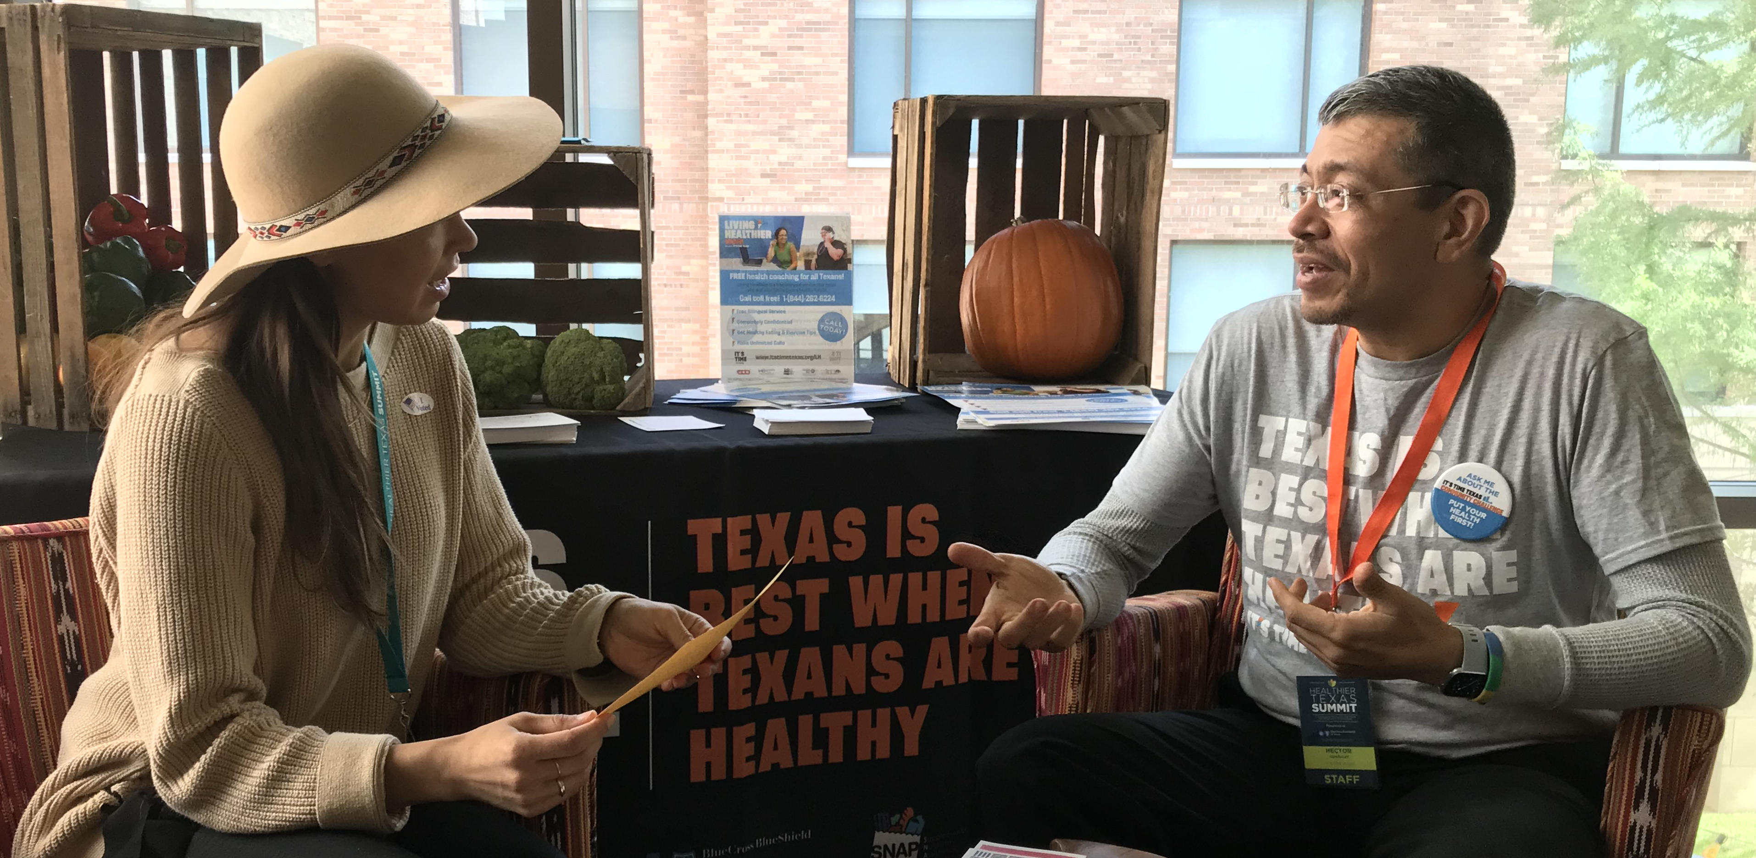
Reflective Listening
What do I think this person means?
Offer your “hunch” in a statement,
Listen carefully to your client’s response.

Slide 21

Reflective Listening
Forms a ”bridge” in the conversation.
The hidden message: “Tell me more.”

Slide 22
Simple vs. Complex Reflections
“I know that smoking is not good for Maria’s asthma, and that I should quit.”
Simple reflection (repeating or rephrasing)
“You’re aware that smoking isn’t good for Maria’s breathing.”
“You’re feeling like you should quit.”
Complex (adds meaning, metaphors, values, emotions, importance)
- “You want to do everything you can to protect Maria’s health and feel that if you were to stop smoking now, it could really help her.”

Slide 23
Questions vs. Reflections
You don’t have time for self-care
You think ketchup is a vegetable
You feel you deserve an extra vacation this year
Notes:
In Year One our goal was to accomplish these 3 things:
Build relationships and trust
Listen to the community and Learn what the needs are
Deliver and evaluate programs to improve mental wellness and enhance self-management of chronic conditions

Slide 24
Exercise: Thinking Reflectively
Goal: To figure out “What is this person trying to tell me? What do they mean?”
In Small Groups: 1 speaker with several listeners
Speaker: “One think I like about myself_____.”
(Choose something that has a depth of meaning)
Listeners: Take a guess at what you think the speaker might mean.
Respond to the speaker with “So you mean that _______”
Speaker: Responds with ONLY “YES” or “NO”
Each speaker will hear 2 rounds of reflections and then switch. Be curious!

Slide 25
Affirmations
Instill hope and belief that client can change or make improvements
Reframe “failures” into successes
Reconnect clients with their strengths
Focus on client characteristics or behaviors

Slide 26
Affirmations
Examples:
You seem really determined to learn everything you can about asthma management.
You’ve been working hard to reduce asthma triggers.
Being a good role model and support to your family is really important to you.
You’re proud of the progress that you’re making, even though there’s more you want to do.

Slide 27
Practicing Reflections
Nancy, a 6-yr old with newly diagnosed asthma lives with her grandmother, Alice, in federally funded housing that needs many repairs. Alice is visibly upset when she tells you that a neighbor recently died from asthma and she is worried that Nancy will die, too. As a CHW working with them, you taught them about 4 main asthma symptoms, which they now understand. Nancy asks if there is a way for her to know that an asthma episode is coming, before symptoms appear. She also wants to reduce triggers in the home.

Slide 28
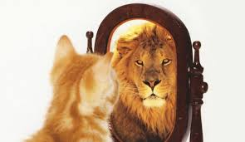

Slide 29

Summaries

Slide 30
Practicing MI – Pulling It All Together
Working in Pairs:
One person is the nurse/helper
The other person is the “speaker”
Nurse role:
Don’t try to persuade or fix anything.
Don’t offer advice.
Ask the next 6 questions one at a time.
Be curious, listen, and reflect back what the person says.

Slide 31
Practice Questions
1. “What matters most to you right now?" - Probe for at least 2 things that are important. Reflect back.
2. "If you were to focus on changing one behavior that you think could make the biggest difference, what might that be?” - Listen
3. “What are your 3 best reasons for wanting to make this change?” – Listen and Reflect back
4. “How important is it for you to make this change? - Listen and Reflect back
5. “If you decided to make this change, how would you go about it?” - Listen and Reflect back
Give a short summary, including the person’s motivations for change:
Desire for change
Ability to change
Reasons for change
Need for change
6. “So, what’s your next step?” or “Where do you go from here?” - Listen with interest to the answer.

Slide 32
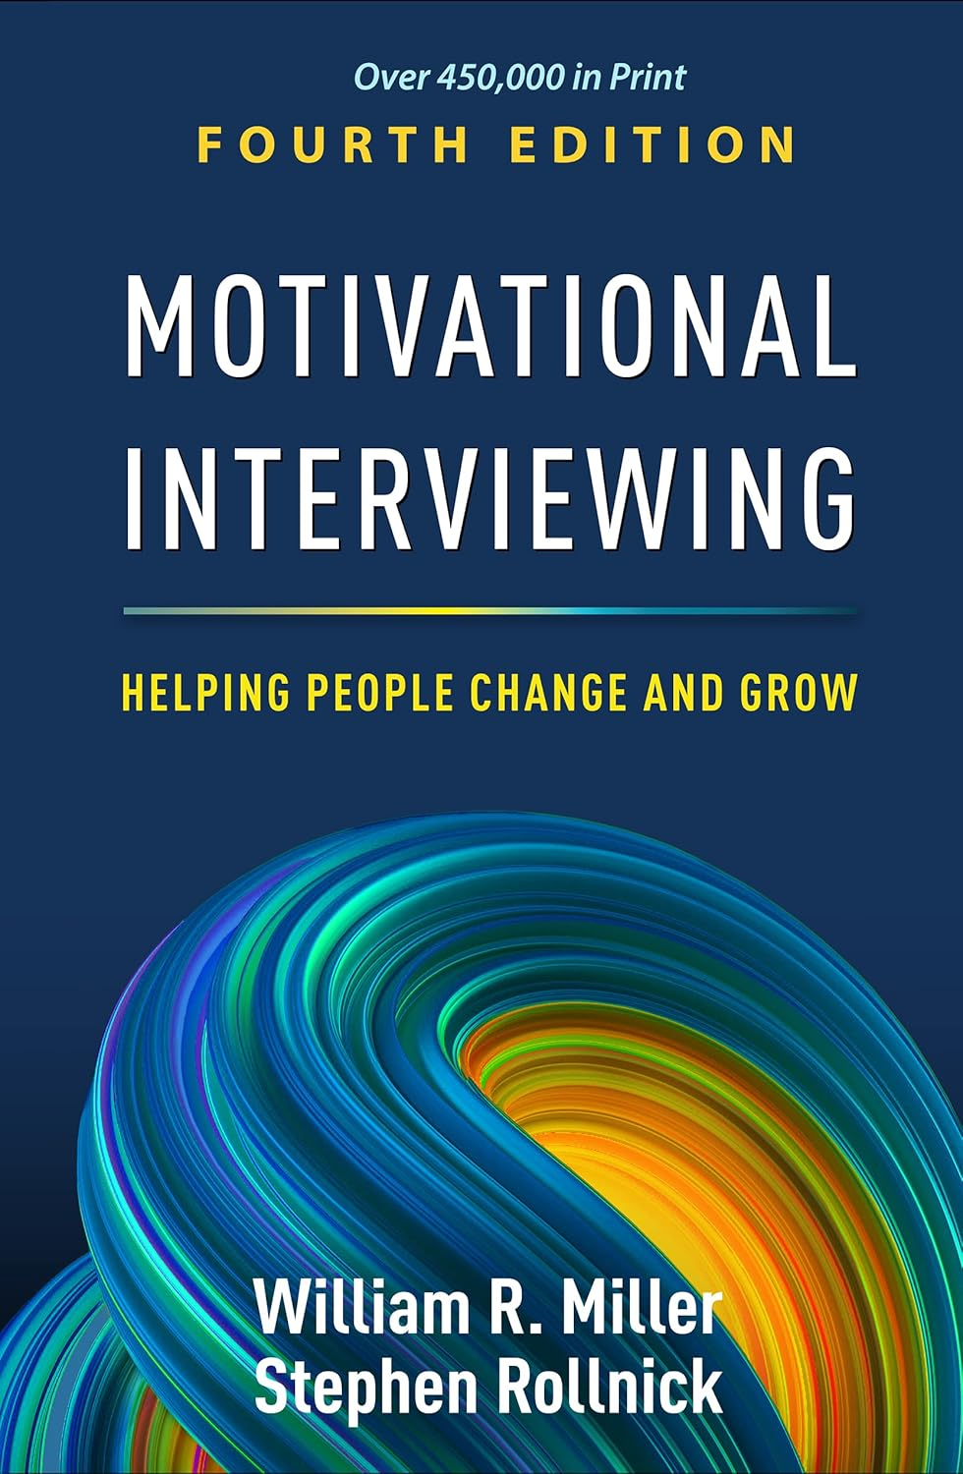
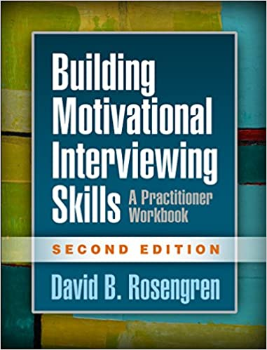

References
Miller, W.R. & Rollnick, S. (2023). Motivational interviewing, 4th edition: Helping people change and grow. New York, NY. The Guilford Press.
Rosengren, David. (2017). Building motivational interviewing skills, 2nd edition. New York, The Guilford Press.
Rollnick, S. Miller, WR, & Butler, CC. (2022). Motivational interviewing in health care: Helping patients change behavior, 2nd edition. New York, NY, The Guilford Press.
Miller, W.R. (2022). On second thought: How ambivalence shapes your life. New York, The Guilford Press.
Miller, W.R. (2021). Effective psychotherapists: Clinical skills that improve client outcomes. New York, The Guilford Press.
Miller, W.R. & Rollnick, S. (2009). Ten things that motivational interviewing is not. Behavioural and Cognitive Psychotherapy, 37, 129–140.

Slide 33


